Slide 1


Department of Information Technology
Session: 2023-2024
Date :03/06/2024
Title of the Project:- LULC Change Detection
Guide:
Prof. Pranay Meshram
Presented By:
Chandrakant Dhule (IT_B_48)

Slide 2


LULC Change Detection Land Use and Land Cover (LULC) Change Detection refers to the process of identifying and analyzing alterations in the types and patterns of land use and land cover over a specific period of time.

Slide 3

Introduction

Slide 4

Land Use and Land Cover (LULC) Change Detection is a critical field of study within the realm of environmental monitoring and geospatial analysis. It focuses on tracking alterations in the way land is utilized and the evolving patterns of surface cover over specific time intervals.
This process is pivotal for understanding the dynamic nature of landscapes, identifying areas undergoing transformation, and assessing the impact of human activities on the environment.
Remote sensing technologies, such as satellite imagery and aerial photography, play a pivotal role in capturing spatial data across large geographical areas. By comparing datasets acquired at different points in time, researchers can identify and characterize changes in land use and cover.
LULC Change Detection has far-reaching implications for environmental science, ecology, urban planning, agriculture, and natural resource management.

Slide 5
Project Aspects :
Study Area Selection: Choose the geographical area of interest based on the project objectives. Consider factors such as size, ecological diversity, and the relevance of the area to the issues being addressed. Data Sources: Identify and acquire appropriate data sources, such as satellite imagery, aerial photographs, or LiDAR data. Consider the spatial and temporal resolution of the data based on the project requirements. Data Preprocessing: Conduct preprocessing steps, including image calibration, atmospheric correction, and geometric correction, to ensure the accuracy and reliability of the data. Change Detection Methods: Select appropriate change detection methods to compare different time periods. This may involve pixel-based or object-based change detection approaches. Integration with Other Data: Consider integrating LULC data with other relevant datasets, such as socio-economic data or climate data, to provide a more comprehensive understanding of the factors influencing land use changes.

Slide 6
Problem Statement

Slide 7

Finding Data for LULC Change Detection in a Specific Area :
In the pursuit of conducting a comprehensive Land Use and Land Cover (LULC) Change Detection analysis for a particular area, the primary challenge lies in acquiring accurate and relevant data. This encompasses satellite imagery, aerial photographs, or other geospatial datasets essential for capturing the landscape's evolution over time. The absence of suitable and up-to-date data hinders the ability to conduct meaningful analyses, limiting our understanding of critical land use changes and their potential environmental impacts.
1. Open Data Initiatives:
Leverage open data initiatives and repositories that provide freely accessible geospatial datasets. Platforms like NASA Earthdata, USGS Earth Explorer, or other national geospatial data portals can be valuable resources for obtaining data.
2. Crowdsourced Data and Citizen Science:
Explore the potential of crowdsourced data and citizen science initiatives to supplement traditional datasets. Platforms like Bhoonidhi or Copernicus.

Slide 8
Specification Software

Slide 9
The software requirements are as follows :
QGIS (Quantum GIS):
Role: QGIS is an open-source Geographic Information System (GIS) software that provides powerful tools for spatial analysis, mapping, and data visualization.
Google Earth Pro:
Role: Google Earth Pro is a user-friendly and widely accessible tool that allows users to explore and analyze geospatial data globally.
Bhoonidhi:
Role: Bhoonidhi is a GIS software developed by the National Remote Sensing Centre (NRSC) in India. It is specifically designed for land management and natural resource monitoring, making it suitable for LULC change detection in the Indian context.
Copernicus (Sentinel Hub):
Role: Copernicus, specifically through the Sentinel Hub, is part of the European Union's Earth Observation program. It provides access to a wealth of Sentinel satellite data, making it valuable for monitoring land changes at a global scale.

Slide 10
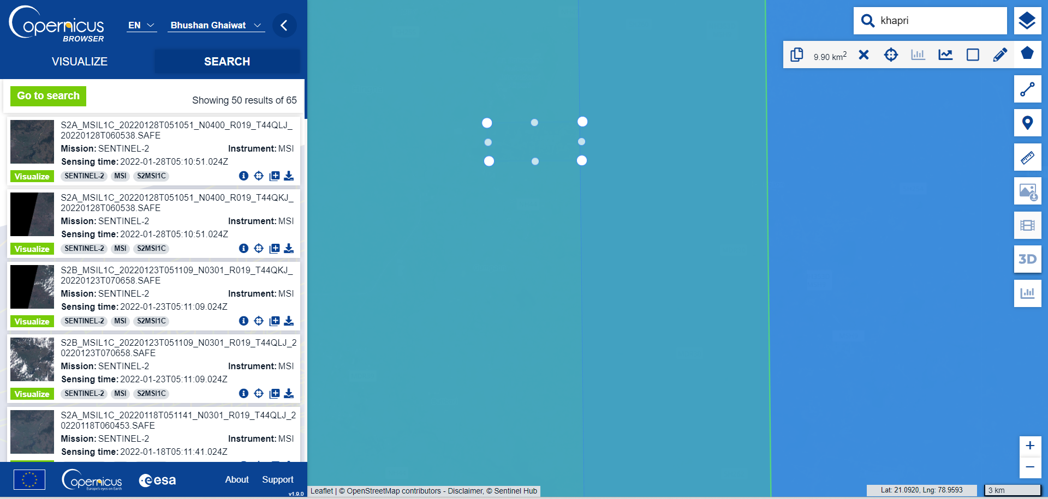
COLLECT THE DATA:

Slide 11
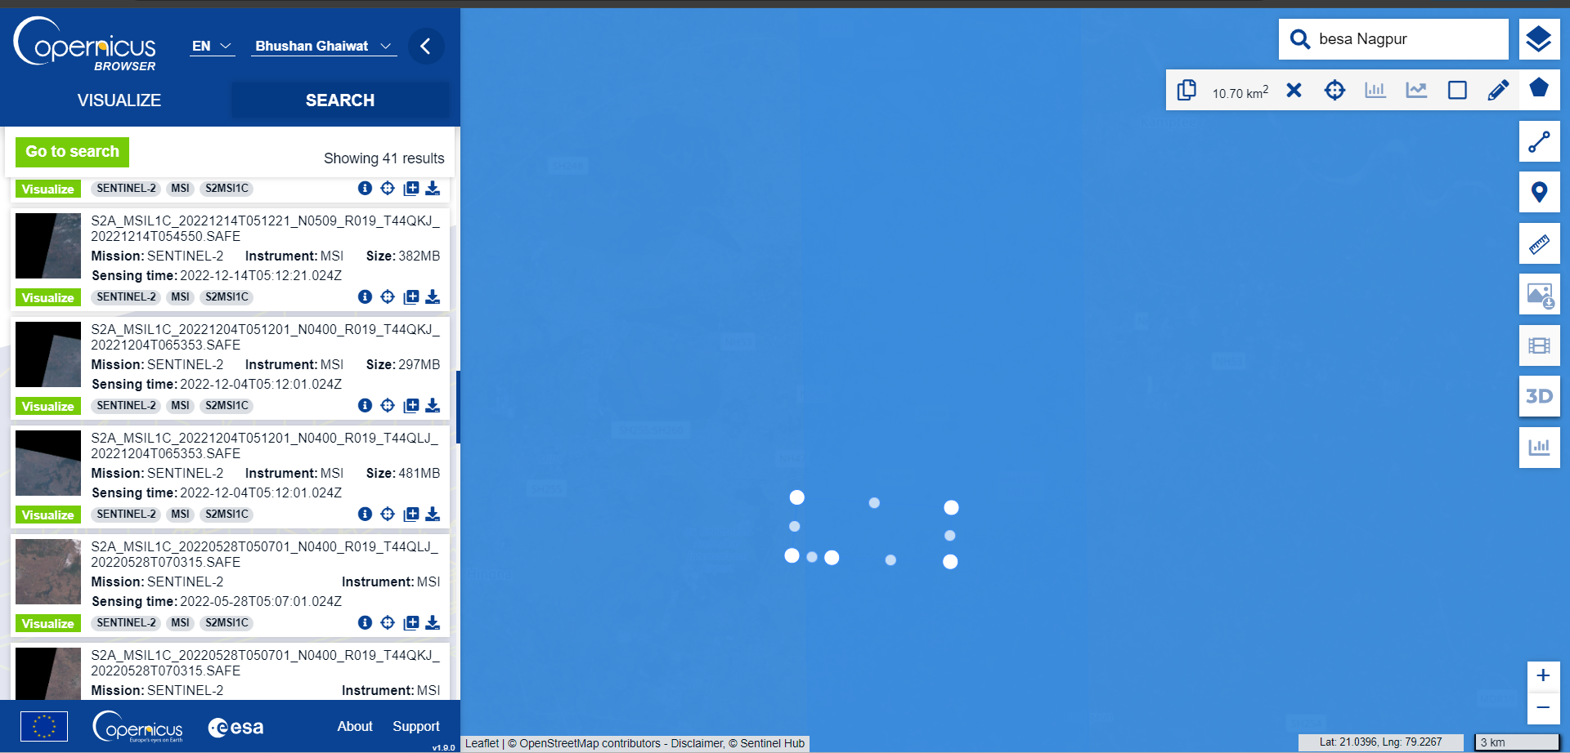

Slide 12
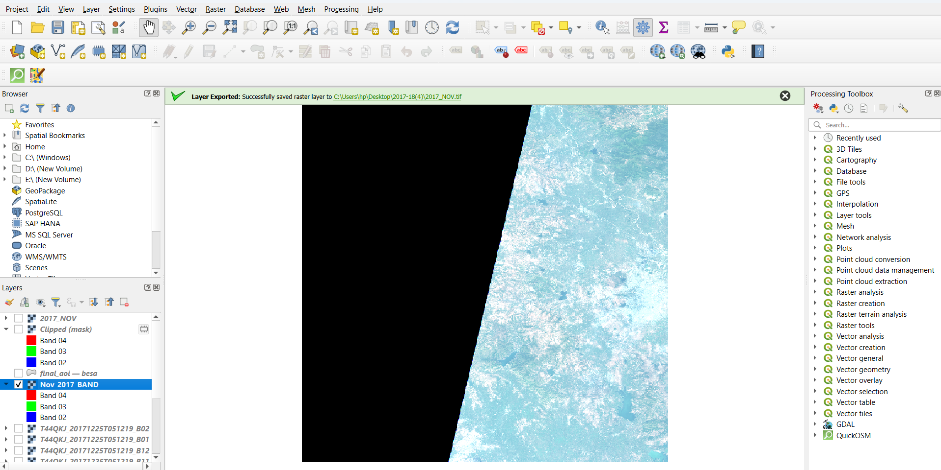
DATA CLEANING:

Slide 13
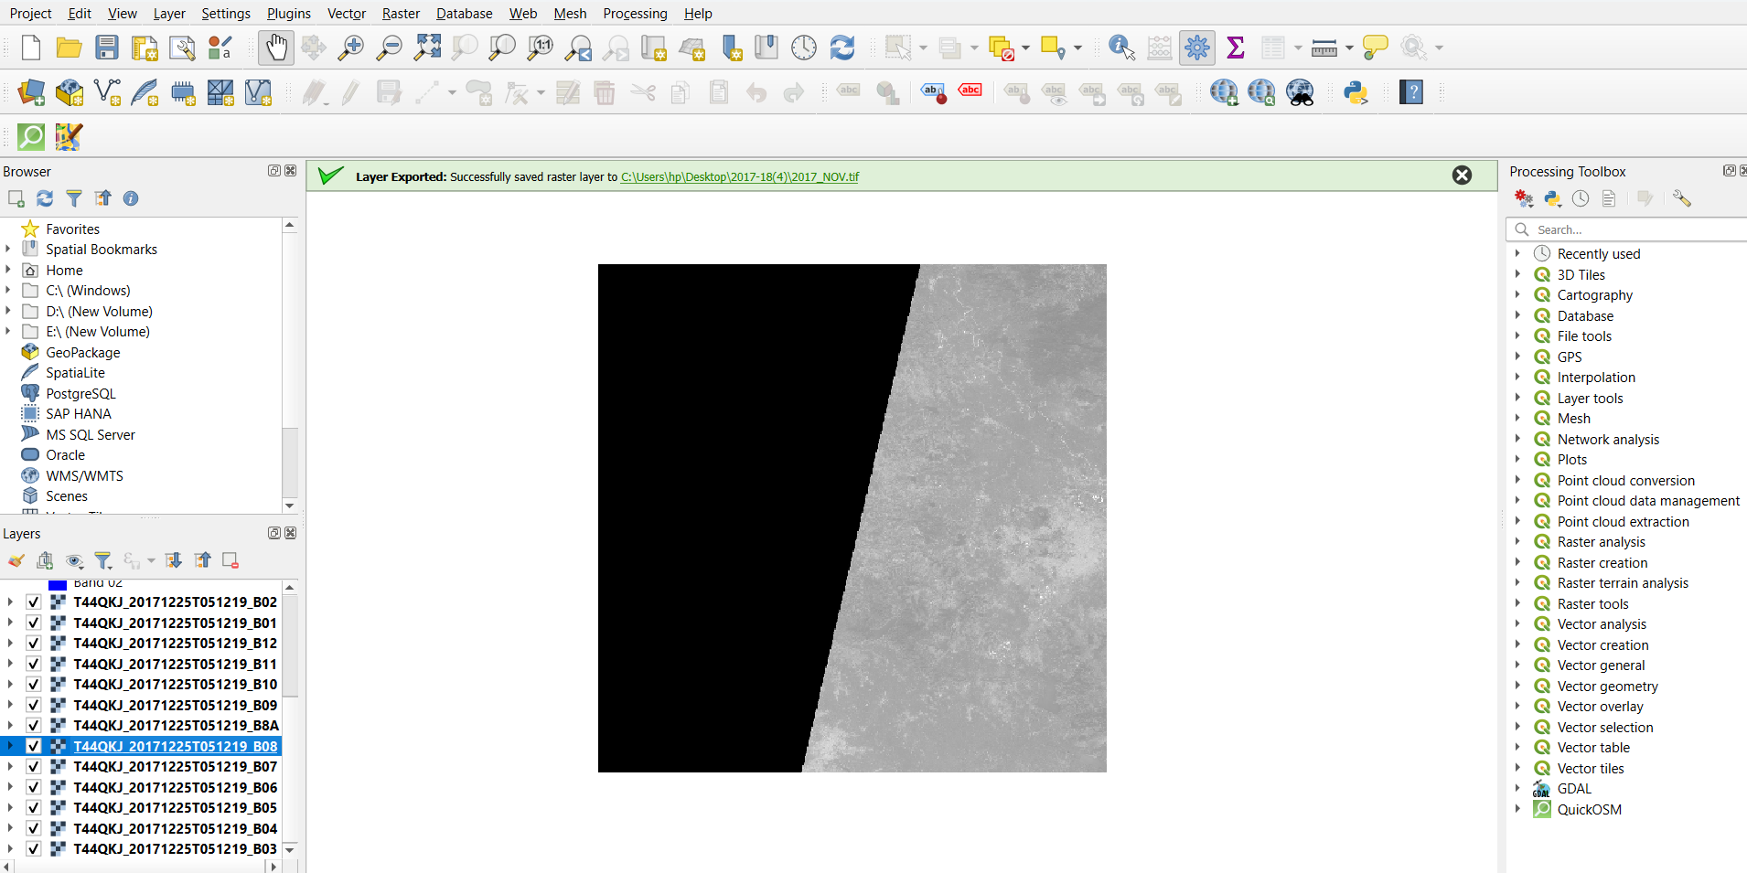
PREPARING BANDSTACK:

Slide 14
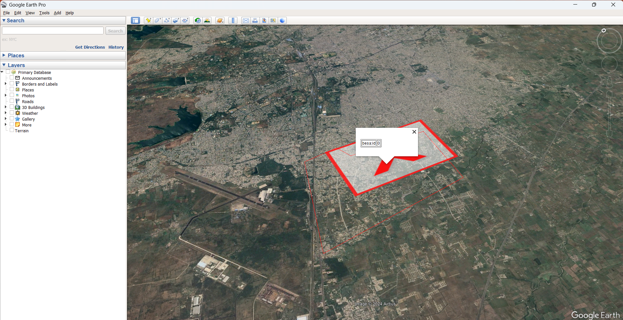
CLIPPING AOI:

Slide 15
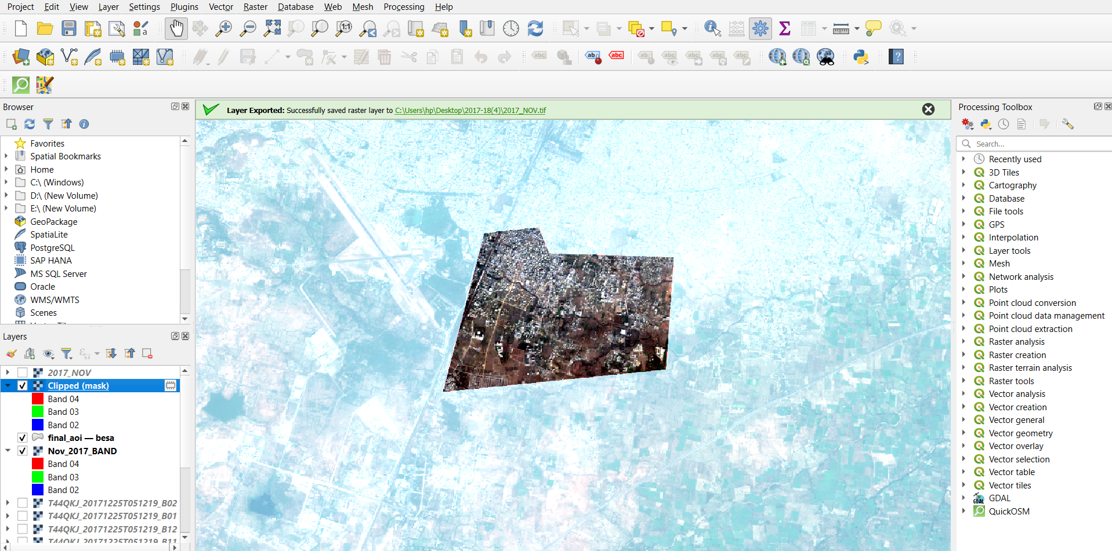

Slide 16
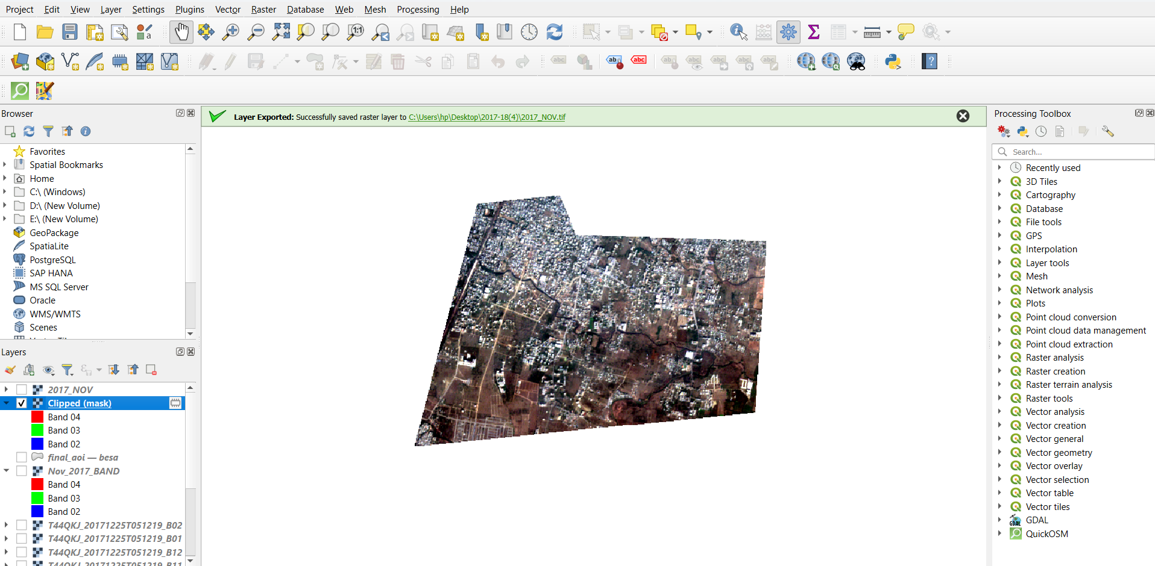

Slide 17
INDICES CALCULATION:
QGIS does not have built-in tools for calculating change detection indices directly, but you can achieve this using raster calculator or plugins. Common indices for change detection include :
index‐based built‐up index (IBI)
soil adjusted vegetation index (SAVI)
normalized difference built‐up index (NDBI)
build-up index (BUI)
new built-up index (NBI)
Built-up Area Extraction Index (BAEI)
Urban Index (UI)

Slide 18
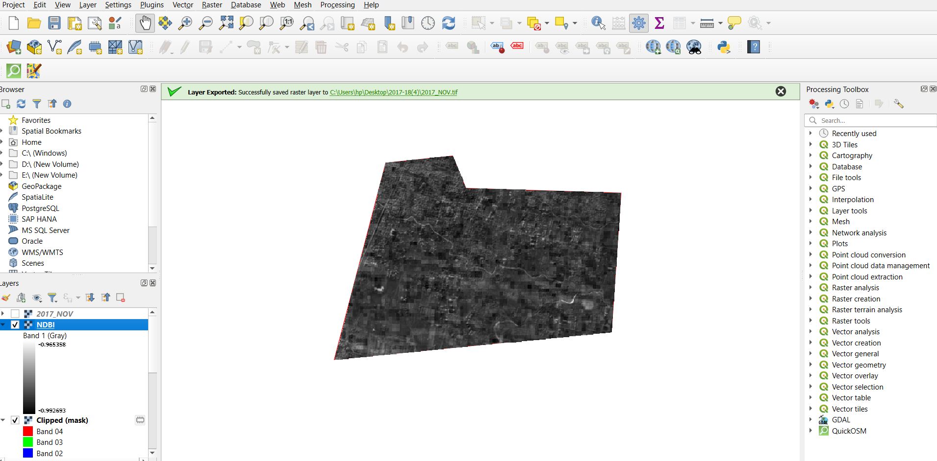
INDICES CALCULATION:

Slide 19
INDICES CALCULATION:

Slide 20
CLASSIFICATION:
Land Use and Land Cover (LULC) change detection involves analyzing changes in the types of land use and land cover over time. There are several classification methods used for LULC change detection, each with its advantages and limitations. Here are some common methods:
Supervised Classification: This method requires training samples for each land cover class, which are used to train a classifier algorithm. Once trained, the classifier is applied to classify land cover types in the images of different time periods. Changes between classifications indicate land cover change.
Unsupervised Classification: In this method, the algorithm identifies clusters of similar pixels without the need for predefined training samples. The user specifies the number of classes desired, and the algorithm groups pixels with similar spectral characteristics. Changes in cluster membership between different time periods indicate land cover change.

Slide 21
Unsupervised algorithms :
Unsupervised algorithms are often favored for LULC change detection when there is limited prior knowledge about the study area or when manual labeling of training data is impractical. Here are a few unsupervised algorithms commonly used for LULC change detection.
K-Means Clustering: K-Means is a widely used clustering algorithm that partitions the data into 'k' clusters based on similarity of attributes. In the context of LULC change detection, each pixel's spectral values are treated as attributes, and the algorithm groups pixels into clusters based on their spectral similarity. Change detection can then be performed by comparing clusters between different time periods.
ISO DATA: ISO data for Land Use and Land Cover (LULC) change detection. ISO (International Organization for Standardization) data usually pertains to standards and specifications for various processes and products, so I'll assume you're referring to remote sensing data captured by satellites or other platforms conforming to ISO standards.
KNN ALGO: Using k-Nearest Neighbors (kNN) for Land Use and Land Cover (LULC) change detection involves a supervised classification approach where the algorithm learns from labeled training data to classify pixels into different land cover classes.

Slide 22
Supervised algorithms :
Supervised algorithms are effective for LULC change detection when there is labeled training data available for each land cover class in the study area. Here are some commonly used supervised algorithms for LULC change detection:
Maximum Likelihood Classifier (MLC): MLC is a widely used parametric classification algorithm that assigns each pixel to the class with the highest probability based on the pixel's spectral signature. It assumes that the spectral values within each class follow a multivariate normal distribution. MLC requires training samples for each land cover class to estimate the parameters of the distribution.
Support Vector Machine (SVM): SVM is a powerful machine learning algorithm that classifies data by finding the hyperplane that best separates different classes in the feature space. SVM can handle non-linear decision boundaries through the use of kernel functions. SVM has been widely applied to remote sensing data for land cover classification tasks, including LULC change detection.
Random Forest (RF): RF is an ensemble learning method that constructs a multitude of decision trees during training and outputs the mode of the classes for classification tasks.

Slide 23
K-MEANS IMAGE CLASSIFICATION:
We used K-means unsupervised classification method along with supervised maximum likelihood classification to classify the pre-processed satellite images for our study area.

Slide 24
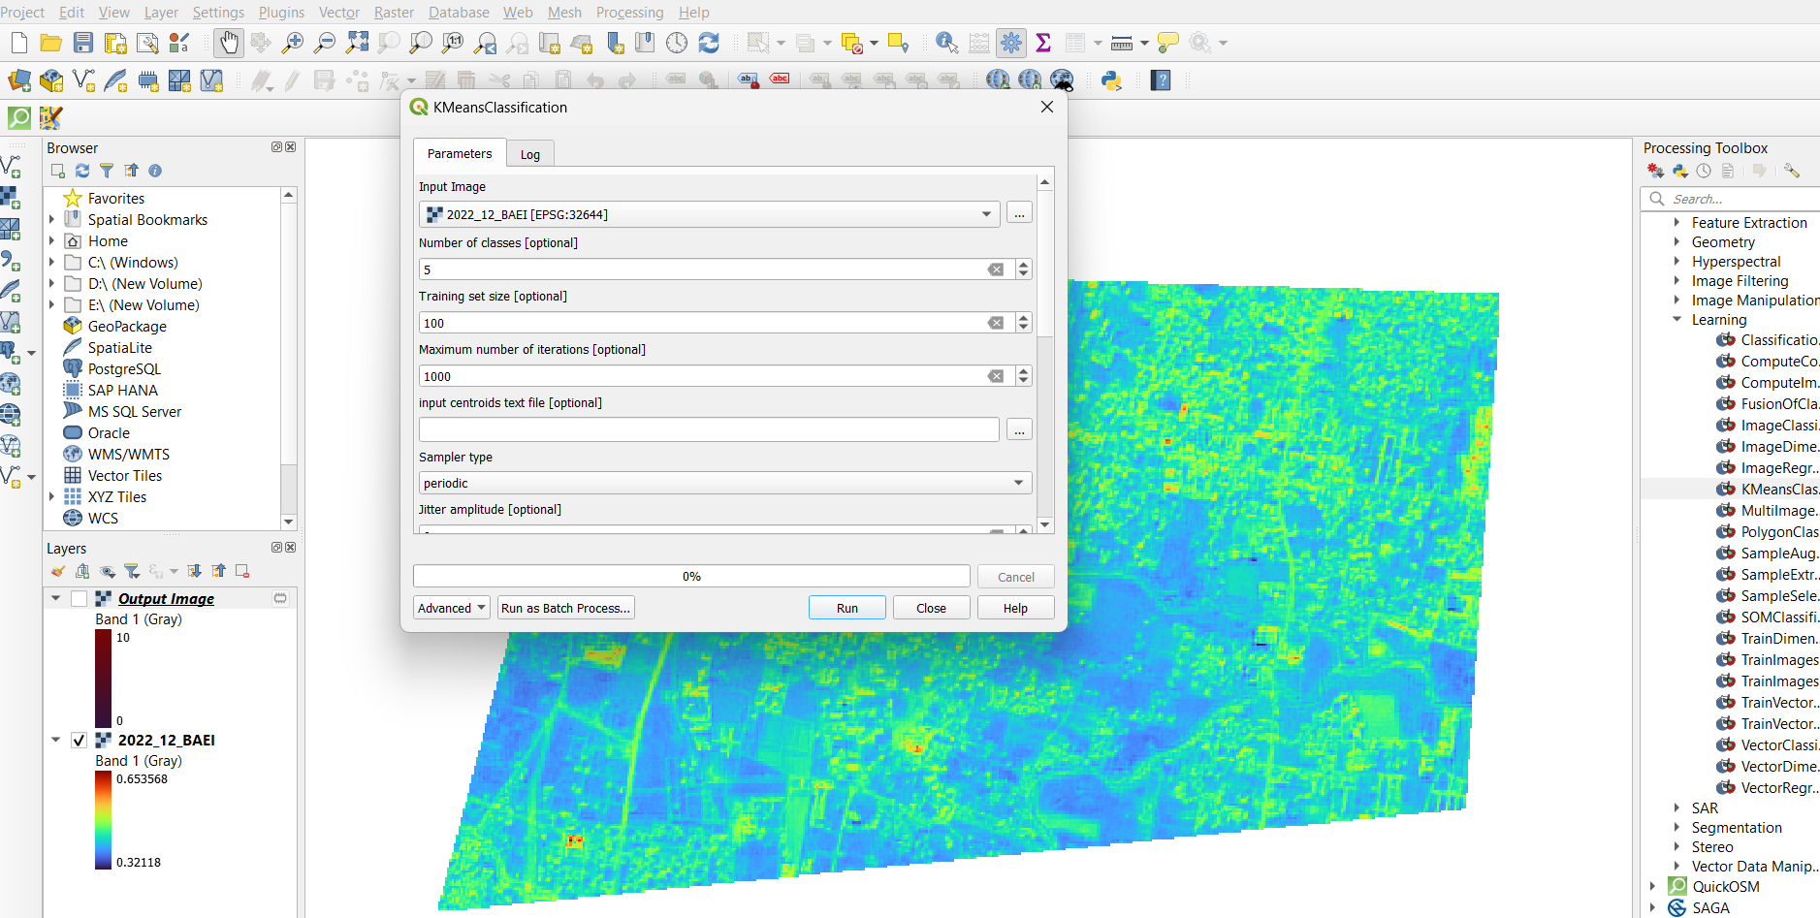
K-MEANS IMAGE CLASSIFICATION:

Slide 25
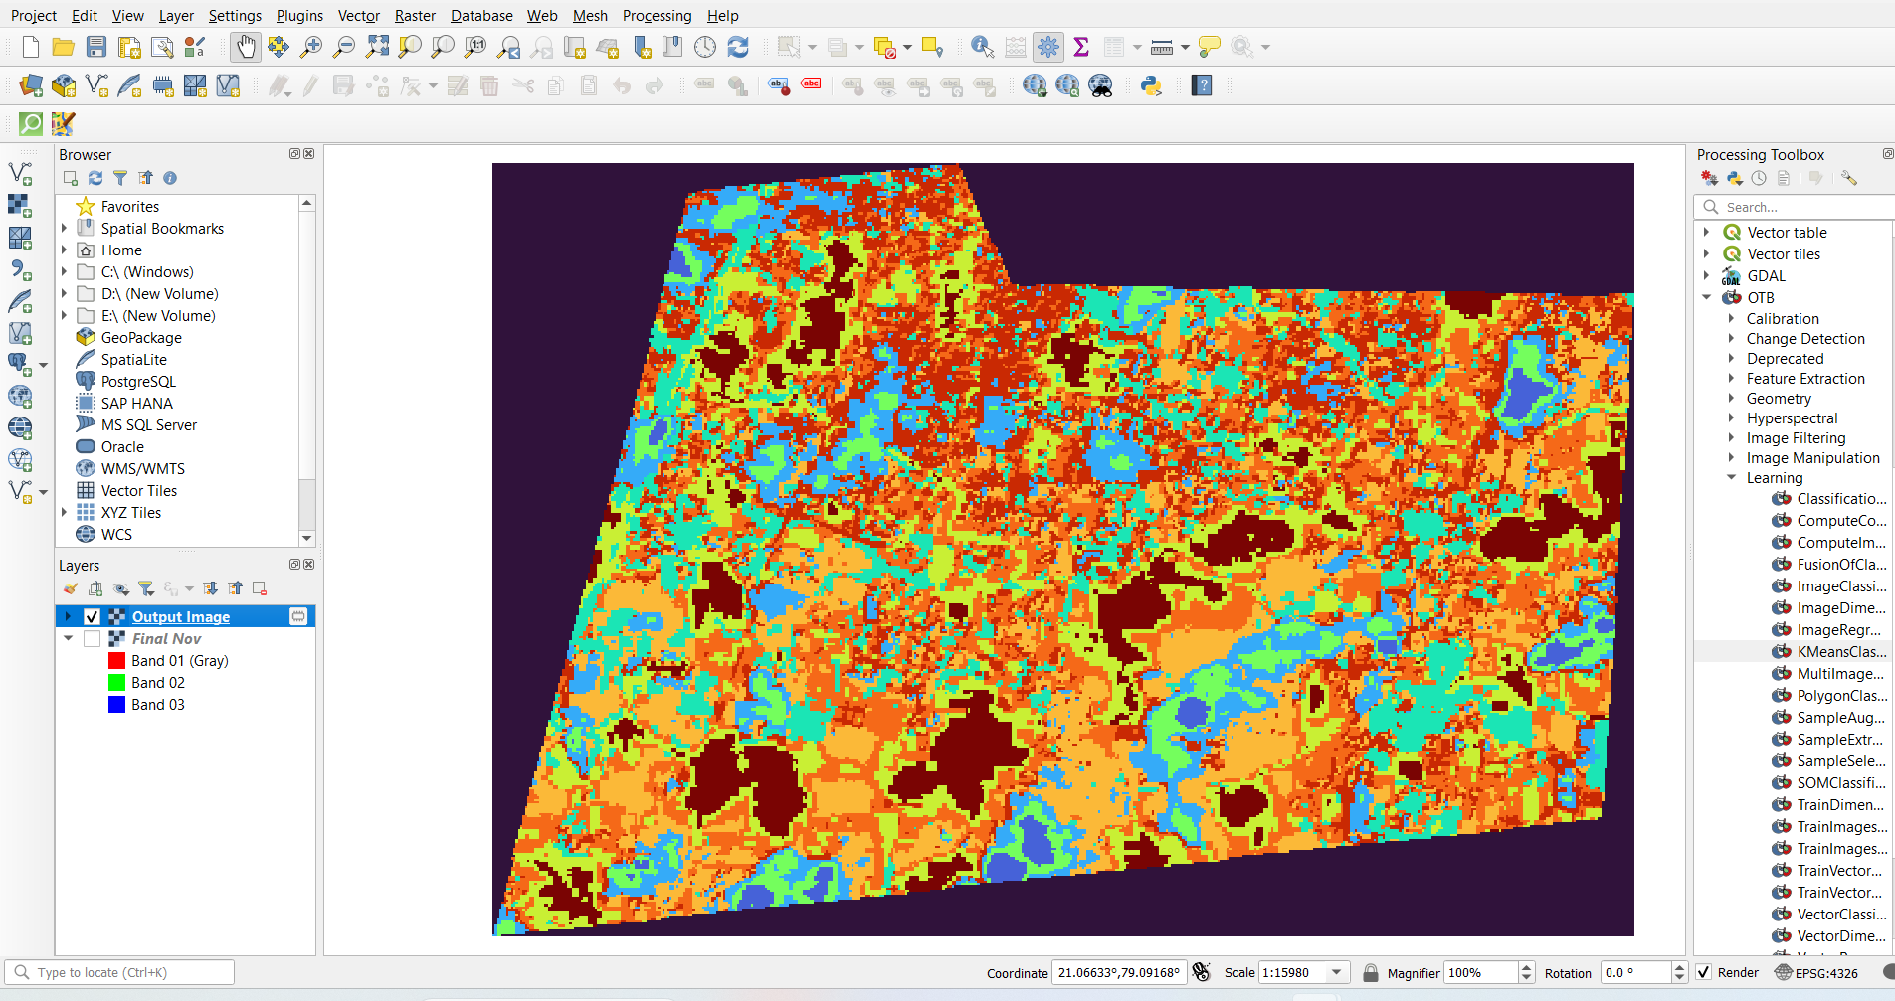
K-MEANS IMAGE CLASSIFICATION:

Slide 26
Conclusion

Slide 27
In conclusion, this LULC Change Detection project has provided valuable insights into the dynamic nature of the studied landscape, contributing to a deeper understanding of land use changes over time.
Through the integration of advanced geospatial technologies and comprehensive analysis methodologies, we have gained significant knowledge that has implications for environmental monitoring, resource management, and sustainable development.
As we conclude this phase of the project, we recognize the need for ongoing research, collaboration, and data-sharing initiatives to address emerging challenges and contribute to the global discourse on sustainable land use practices.

Slide 28
Future Scope

Slide 29
1. Urban Dynamics and Smart City Planning:
Focus on urban dynamics, considering the increasing trend of urbanization globally.
2. Climate Change Impact Assessment:
Extend the scope of LULC Change Detection to assess the impact of climate change on land use patterns.
3. Community-Driven Monitoring Initiatives:
Foster community engagement and citizen science initiatives to involve local communities in monitoring and reporting land use changes.
4. Development of Decision Support Systems:
Develop decision support systems that integrate LULC change information with socio-economic data.
5. Investigation of Land Use Change Drivers:
Conduct in-depth studies on the drivers of land use changes, including economic, demographic, and policy factors.

Slide 30
References

Slide 31
[1] Ahmad, S. (2014). Land use change detection using remote sensing and artificial neural network: Application to Birjand, Iran. Computational Ecology and Software, 4, 276.
[2] Akpoti, K., Antwi, E. O., & Kabo-Bah, A. T. (2016). Impacts of rainfall variability, land use and land cover change on stream flow of the black Volta Basin, West Africa. Hydrology, 3(3), 26
[3] Belay, T., & Mengistu, D. A. (2019). Land use and land cover dynamics and drivers in the Muga watershed, Upper Blue Nile basin, Ethiopia. Remote Sensing Applications. Society and Environment, 15, 100249.
[4] Chakilu, G., & Moges, M. (2017). Assessing the land use/cover dynamics and its impact on the low flow of Gumara Watershed, Upper Blue Nile Basin, Ethiopia. Hydrol Current Res, 7, 2. doi: 10.4172/2157-7587.1000268
[5] Sewnet, A. (2015). Land use/cover change at infraz Watershed, North westren Ethiopia. Journal of Landscape Ecology, 8(1), 69–83.

Slide 32

Thank You!

